Slide 1

Shiny
Web development through R

Slide 2
Outline
Workshop sessions
Introduction, Structure & Basics - 10th Jan
More advanced elements – 17th Jan
Interactivity and renderUI – 24th Jan
Troubleshooting & “BYO-App” session Fisheries Informatics project – 31st Jan
– Optional hands on session
Github session

Slide 3
Session 1
Outline
Introduction to shiny
Structure & Basic code template
6 basic examples
Fisheries Informatics apps
- Interesting functionalities

Slide 4

Shiny!

Slide 5
Shiny
What is it?
An R package that makes it easy to build interactive web applications (apps) straight from R.
Combines the computational power of R with the interactivity of the modern web.
Can host standalone apps on a webpage, embed them into R markdown documents or build dashboards
Extend your shiny apps with
CSS themes
Html widgets
JavaScript actions

Slide 6
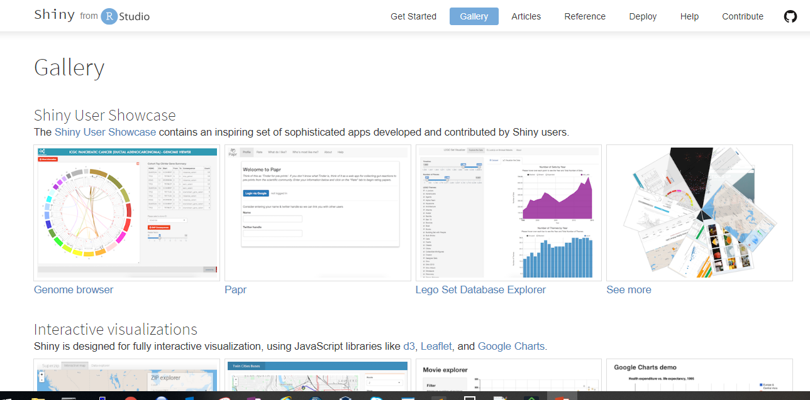
Shiny - options

Slide 7
Structure
ui
What it looks like
app.R
(R script)
What it does
server
Makes it work
shinyApp(ui,server)

Slide 8
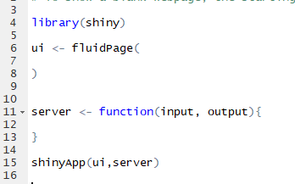
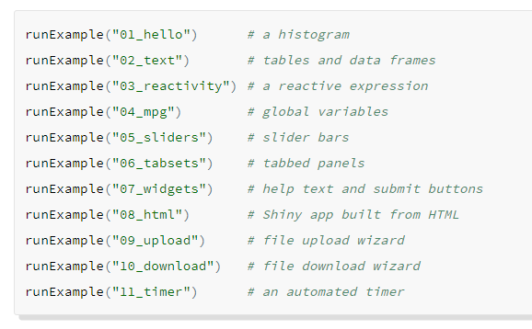
R code
Template – Example 1-0
Examples – Built in

Slide 9
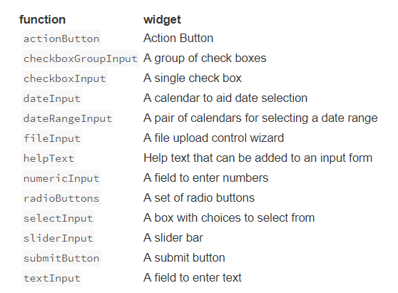
Widgets
To add a widget, place a widget function in your ui object with;
A name for the widget. The user will not see this name but you can use it to access the widgets value and create reactive elements based on it.
A label. This should be a character string and will appear with the widget in your app. it can be an empty string “”.
In this example the name is “action” and the label is “Action”

Slide 10
Now you…
Examples 1-6

Slide 11

Fisheries Informatics Project
MI based project aiming to visualize existing data, increase its usage/utility and make it more easily accessible.
Outputs;
Species Dashboard
Digital Stockbook
IGFS data explorer
Cod tagging data portal

Slide 12
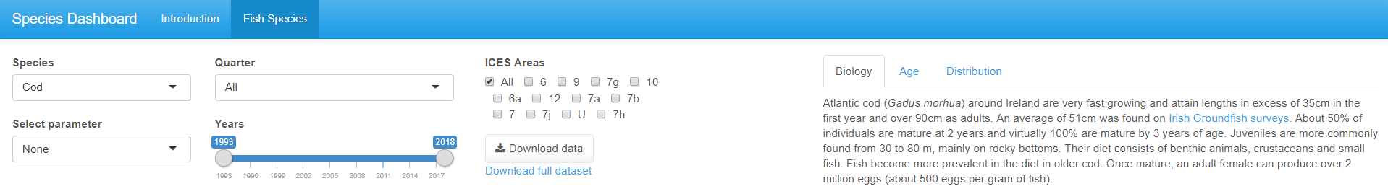
Species Dashboard
Multiple tabs
Interactive plots
images
tabPage
plotly
www folder and renderImage
Action buttons
tabPage

Slide 13
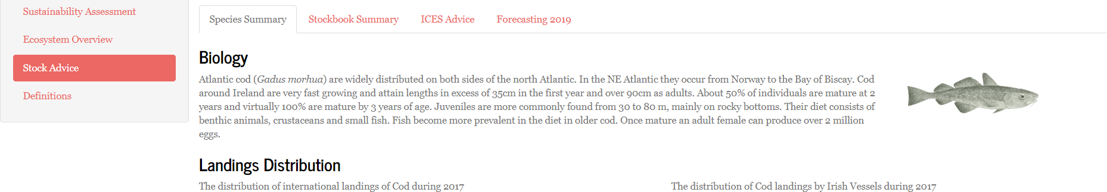
Digital Stockbook
Reactive filters
Reactive content
Selecting Stock different dropdown options based on species selected
renderUI
renderUI

Slide 14
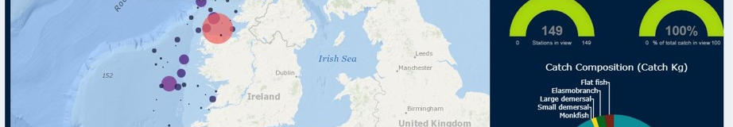
IGFS Data Explorer
Leaflet pop-ups
View & download PDF
Reactive charts and infoboxes

Slide 15
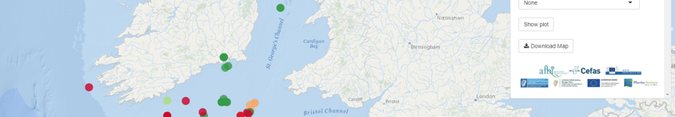
Cod tagging
Leaflet + adaptive page
Download map
Modal Dialog Box
downloadHandler
Creates filename and content of file

Slide 16

Session 2
Outline
Layout options
HTML and formatting
Plotly
Leaflet
Fisheries Informatics apps
- the code that built them

Slide 17
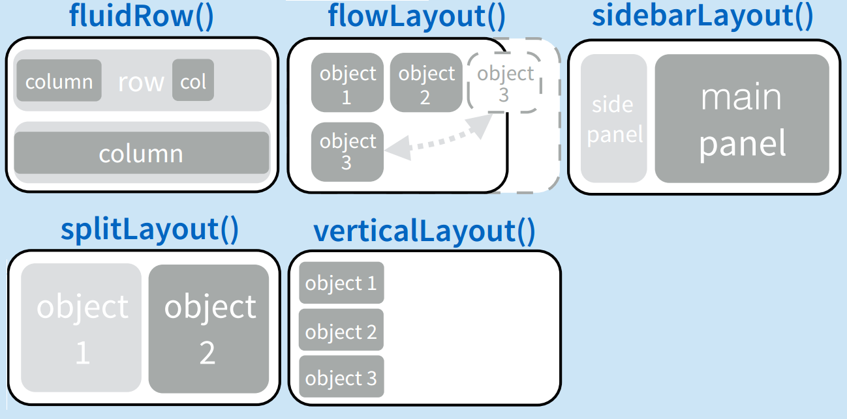
Layout
fluidPage
Most used and very flexible
titlePanel and sidebarLayout are most commonly used elements to add.
Combine multiple elements using different panel functions.
Organise panels and elements into a layout using a layout function with elements as arguments.

Slide 18
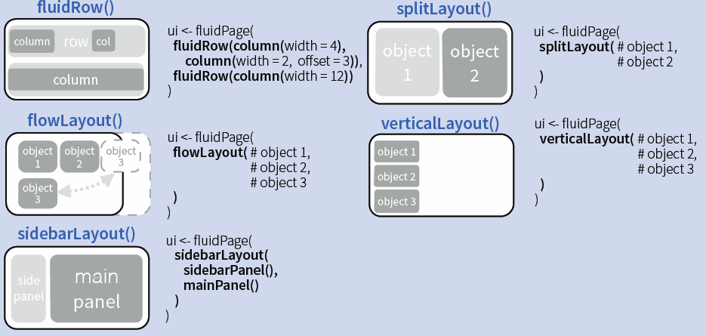
Layout code examples

Slide 19
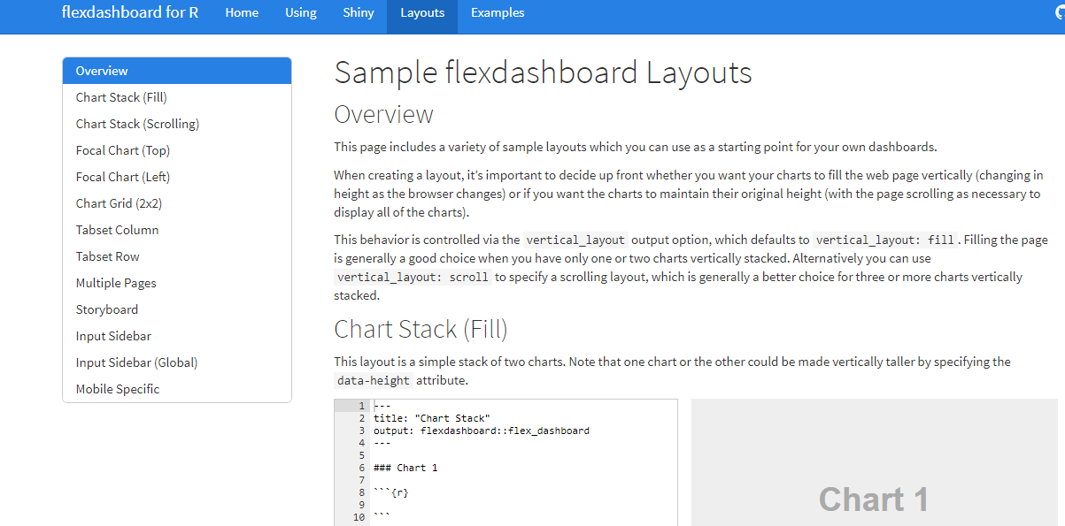
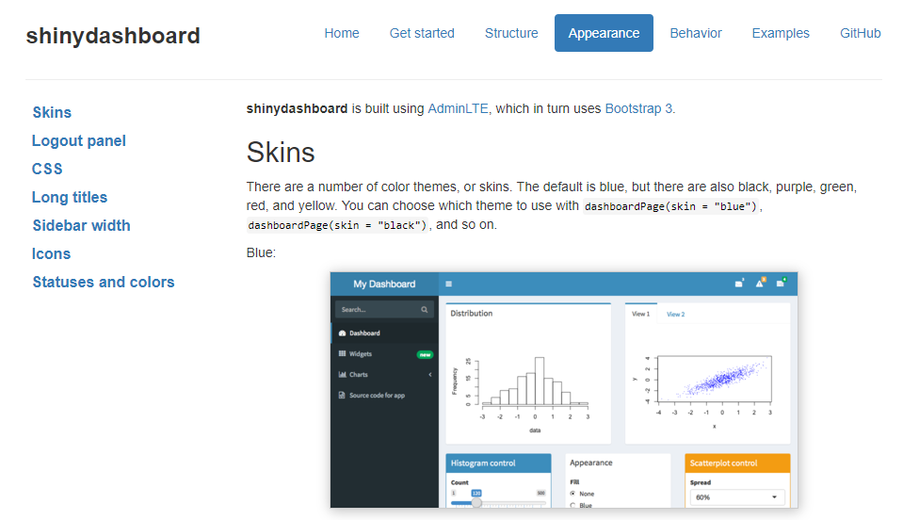
Layout
flexdashboard
shinydashboard
R Markdown
Super easy
Static or Dynamic
CSS flexbox layout
link
Shiny UI code, built using AdminLTE
Not quite as easy
Dynamic
Bookstrap grid layout
link
For more - layout-guide

Slide 20
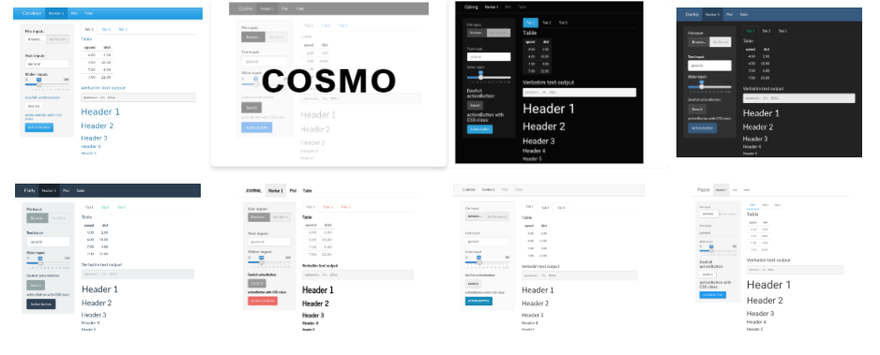
Shinythemes
https://rstudio.github.io/shinythemes/
Some options:

Slide 21
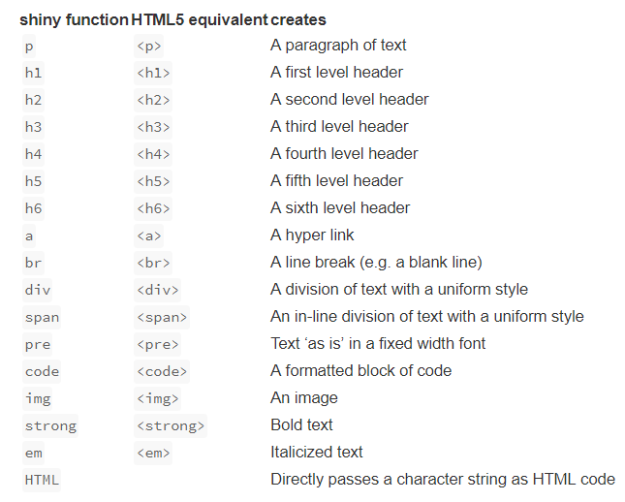
Adding content & Formatting
You can add content to your Shiny app by placing it inside a *Panel function e.g. sidebarPanel("sidebar panel")
Format text using inbuilt tags to create Headers, alter alignment, bole/italicize, change colour etc.
You can also customize your UI with HTML
Shiny HTML tags glossary
Notes:
You can add content to your Shiny app by placing it inside a *Panel function
Adding characters; html site hyperlink so you can look up the appropriate wrapper tag to allow you to include unusual characters (e.g. less than or equals to sign, subscript etc)

Slide 22
Adding links
runApp(
list(ui = fluidPage(
uiOutput("tab")
),
server = function(input, output, session){
url <- a("Google Homepage", href="https://www.google.com/")
output$tab <- renderUI({
tagList("URL link:", url)
})
})
)
HTML syntax within a block of text:
<a href="https://www.marine.ie/Home/home" target="_blank">www.marine.ie</a>
Notes:
Target=“_blank” – opens the link in a new tab, if this is removed it will open on the same page
The second link is what would appear in the text. Could be changed to “click here”

Slide 23
Sharing your apps
R scripts
This is the simplest way to share an app, but it works only if your users have R on their own computer (and know how to use it). Users can use these scripts to launch the app from their own R session, just like you’ve been launching the apps so far in this tutorial.
Need a copy og your app.R file, as well as any supplemental materials used in your app (e.g. the ‘www’ folder etc)

Slide 24
Sharing your apps
Web page
This is definitely the most user friendly way to share a Shiny app. Your users can navigate to your app through the internet with a web browser. They will find your app fully rendered, up to date, and ready to go
Rstudio offers 4 ways to host your Shiny app as a web page;
shinyapps.io
Shiny Server
Shiny Server Pro*
RStudio Connect*
*for closer control, larger volumes and requires purchase

Slide 25
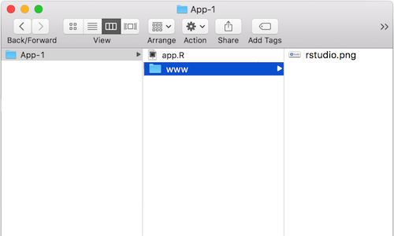
Images
‘img’ function with name of your image file as src argument
Can also include HTML friendly parameters like heights and width (numbers refer to pixels)
Img fuction looks for your image in a specific place; so your file must be in a folder named ‘www’ in the same directory as your app.r script.
So if you wanted to use an image called rstudio.png, your App-1 directory should look like this;

Slide 26
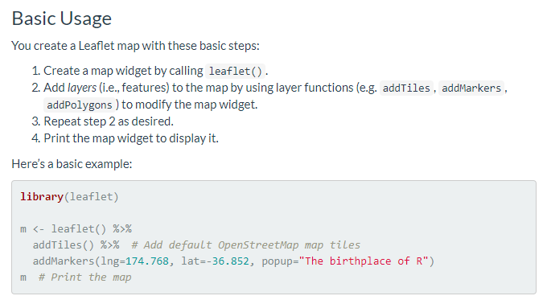
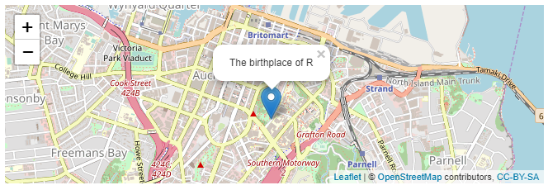
Mapping - leaflet
ui <- renderLeaflet(m)
More info: https://rstudio.github.io/leaflet/

Slide 27
Incorporating plots/graphs
Plot fuction
Normal R plotting code inside renderPlot()
ggplot
Notes:
Tidyverse integration,

Slide 28
Interactive plots - Plotly
https://plot.ly/r/
Can also wrap ggplot inside renderPlotly(); will make your plot interactive

Slide 29
ggplot example
Normal gg plot code – output as is
Wrap within plotly and demo interactivity

Slide 30
Tables - Datatable

Slide 31
Session 3
Outline
Interactivity
renderUI function
Troubleshooting
Reactive plotting – tagging app, code to allow you to chose your plot parameters
Tips and tricks
- Additional resources

Slide 32
Google analytics

Slide 33
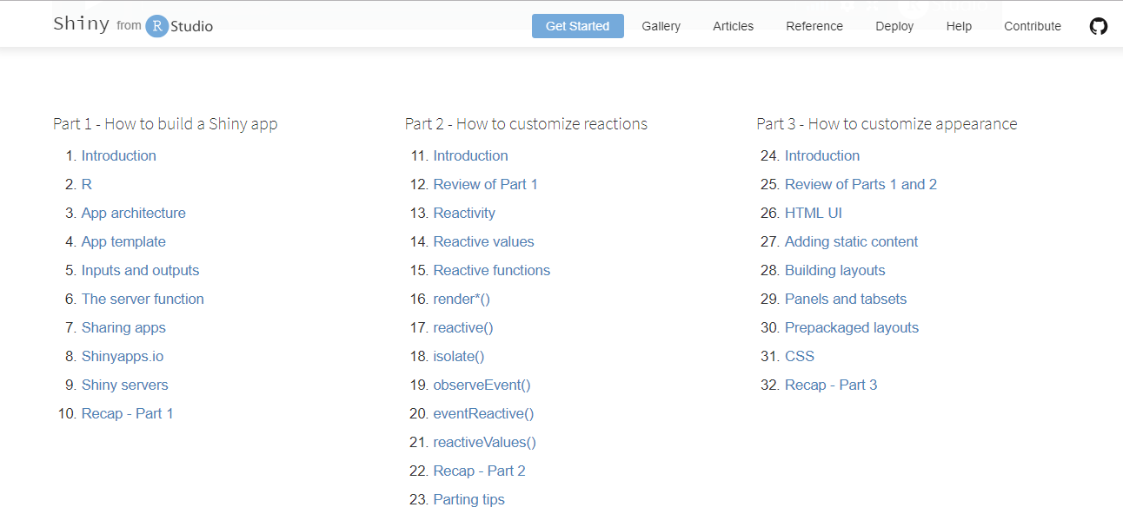
Shiny – Online tutorials
https://shiny.rstudio.com/tutorial/

Slide 34
Other Resources
https://www.rstudio.com/products/shiny/shiny-user-showcase/
https://shiny.rstudio.com/gallery/
http://gallery.htmlwidgets.org/
https://www.r-graph-gallery.com/
https://rmarkdown.rstudio.com/flexdashboard/
https://github.com/d3/d3/wiki/Gallery
http://myinspirationinformation.com/visualisation/d3-js/integrating-d3-js-into-r-shiny/
https://rstudio.github.io/promises/articles/shiny.html
http://spatial.ly/
https://flowingdata.com/category/tutorials/

Slide 35

Questions?

